Slide 1

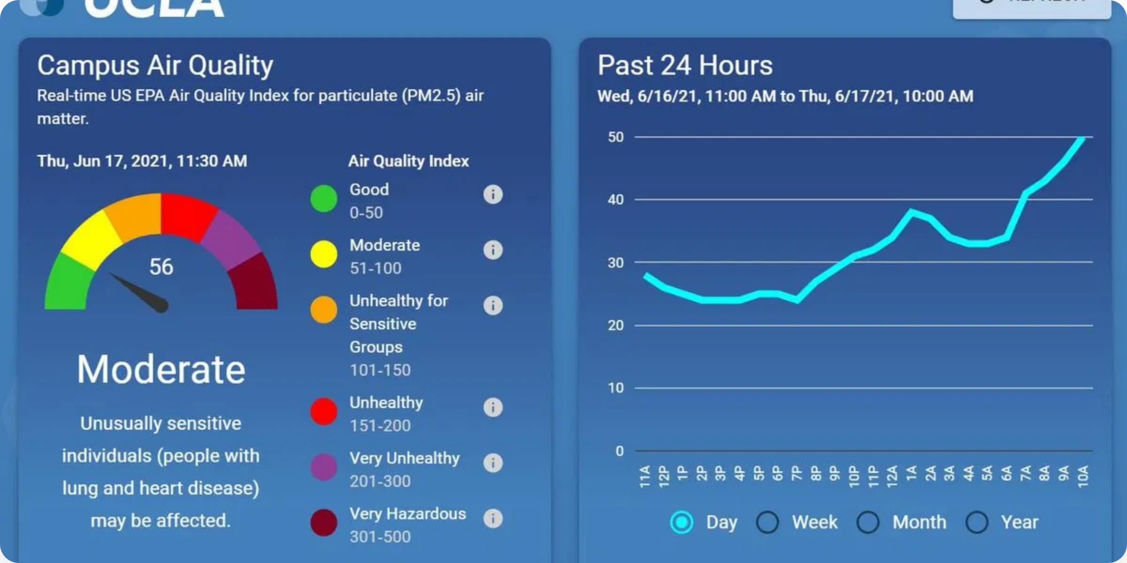
Air Quality Visualizer and Forecast App
Real-time, Historical, and Predictive Air Quality Information
Good
Moderate
Unhealthy for Sensitive Groups
Unhealthy
Very Unhealthy
Hazardous
Bridging the data gap for underserved regions

Slide 2

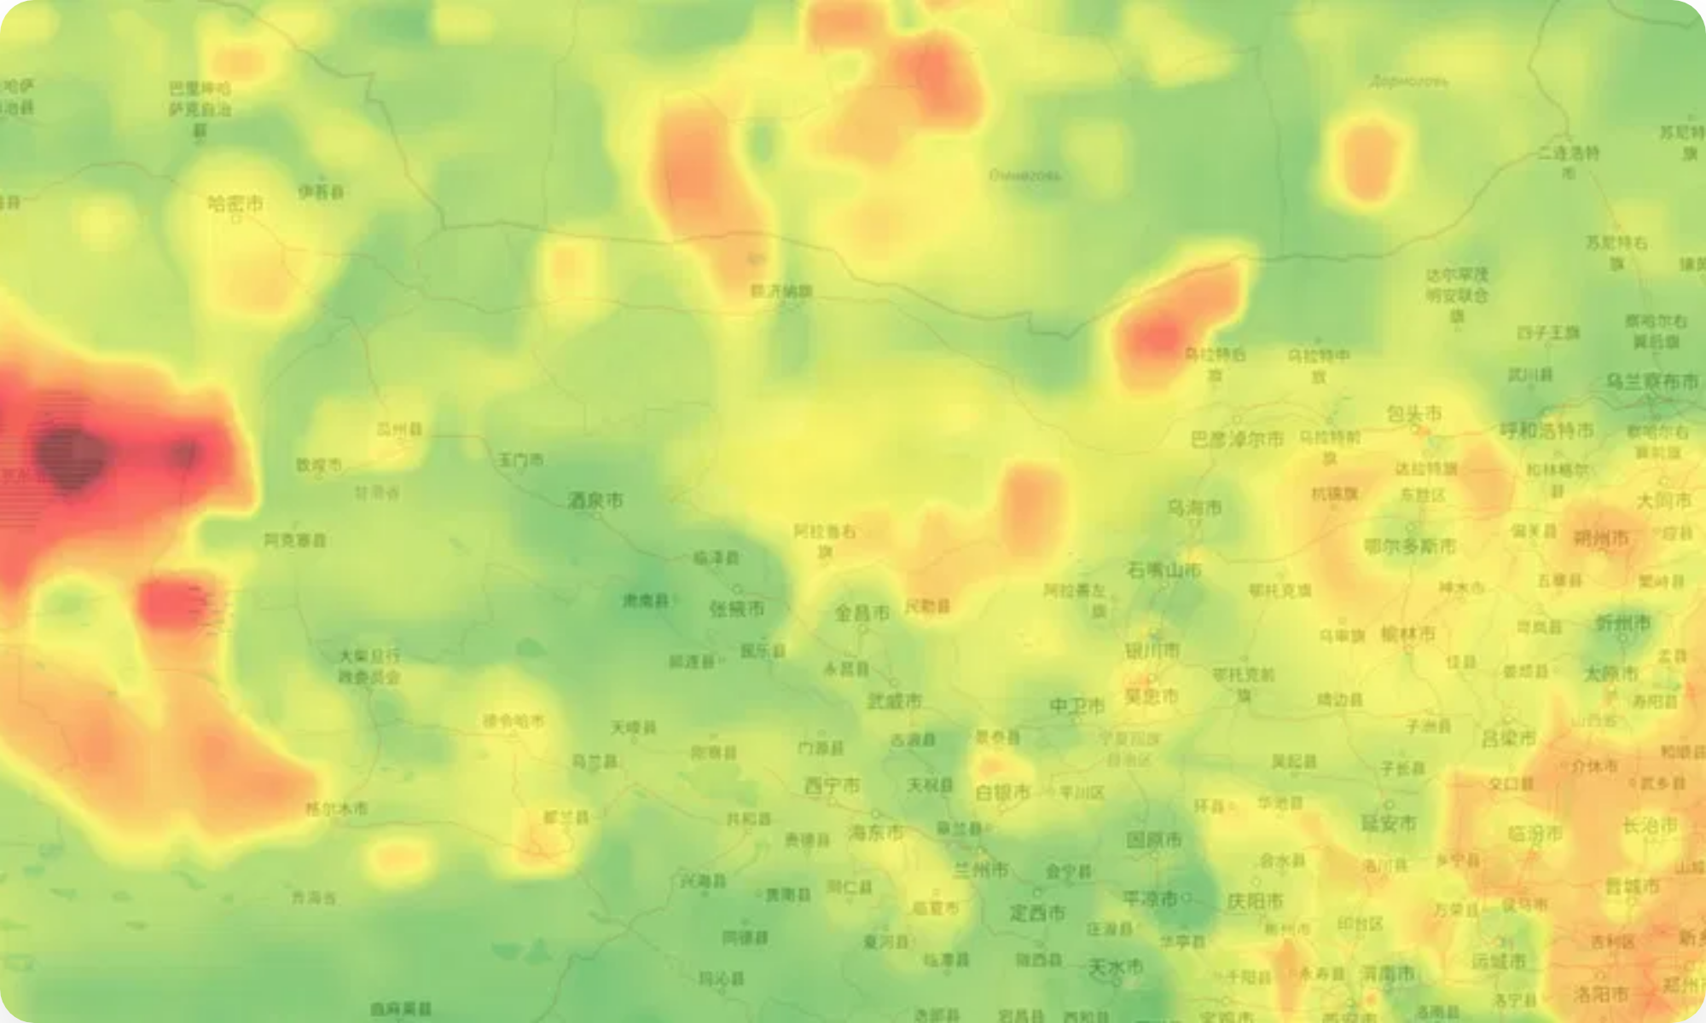

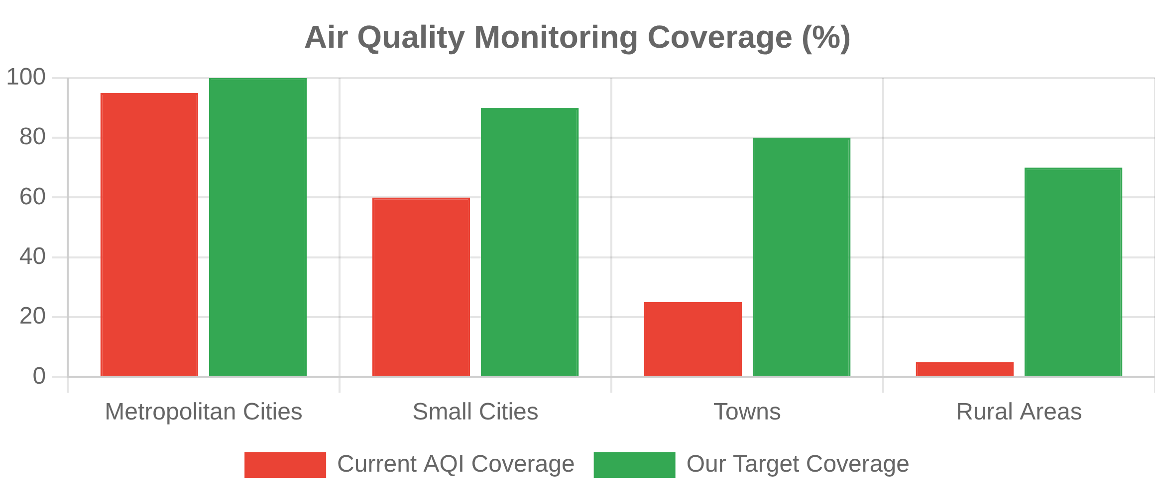
Problem Statement
Challenges in Air Quality Monitoring
Limited Coverage:
Most AQI apps focus only on large metropolitan areas, leaving small towns and rural areas without accurate data.
Data Gaps:
Lack of granular, hyperlocal air quality information creates blind spots in pollution monitoring.
Reactive Approach:
Current systems provide only real-time data without predictive capabilities, limiting preventive actions.
Health Impact:
Without accurate air quality forecasts, vulnerable populations cannot take timely precautions.
Air Quality Visualizer and Forecast App
2/10

Slide 3

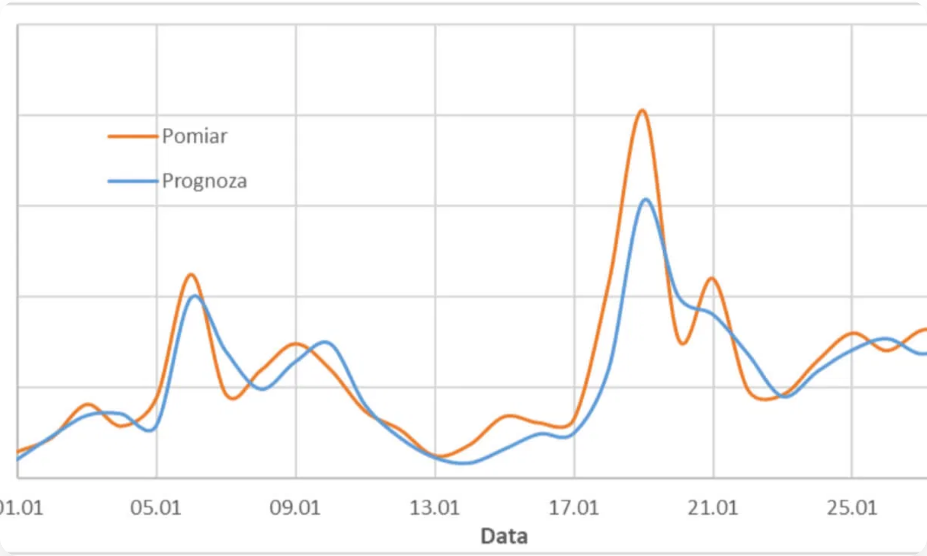





Our Solution
Bridging the Air Quality Data Gap
Comprehensive Coverage:
Combining ground station data with satellite imagery to provide air quality information even in underserved regions.
Predictive Intelligence:
Advanced machine learning models that forecast air quality 24-72 hours ahead, enabling proactive measures.
Personalized Health Insights:
Tailored recommendations based on individual health profiles and local air quality conditions.
Real-Time AQI Maps
Historical Trends
Interactive Visualization:
Color-coded visualization of current air quality across regions
Analysis of air quality patterns over time
User-friendly interface with intuitive maps, charts, and alerts for easy understanding of complex air quality data.
3-Day Forecasts
Smart Alerts
Predictive air quality information for planning
Timely notifications when air quality deteriorates
Air Quality Visualizer and Forecast App
3/10

Slide 4

















System Architecture
Frontend
Backend
Data & ML
DevOps & Analytics
HTML5, CSS3, JavaScript
Node.js + Express
TensorFlow Lite
Jest for testing
React / Flutter
Python for data processing
Hugging Face models
Firebase Analytics
Leaflet.js / Google Maps API
Supabase DB
Satellite/CPCB data for AQI
Performance monitoring
Chart.js for visualizations
Firebase Notifications
Weather API integration
Cross-platform support
Air Quality Visualizer and Forecast App
4/10

Slide 5



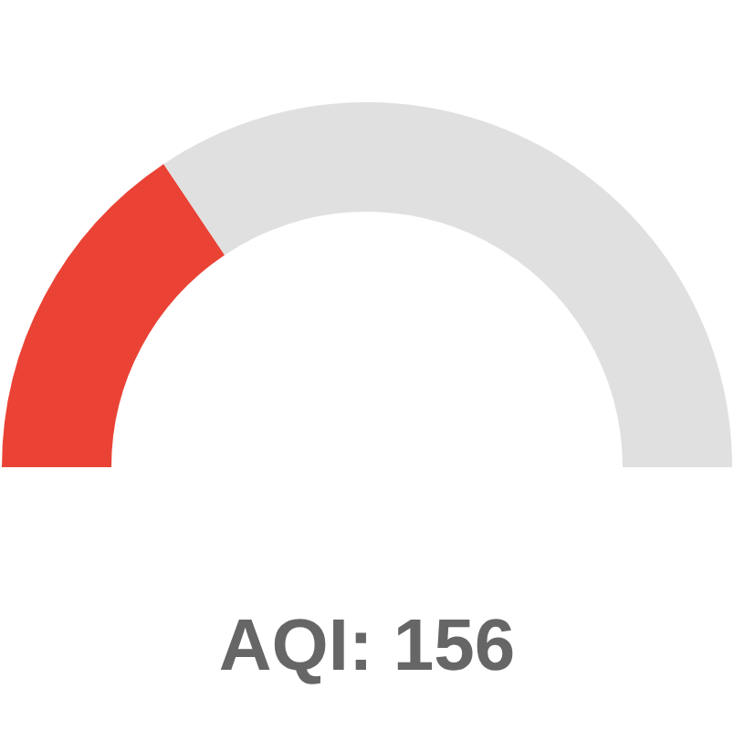



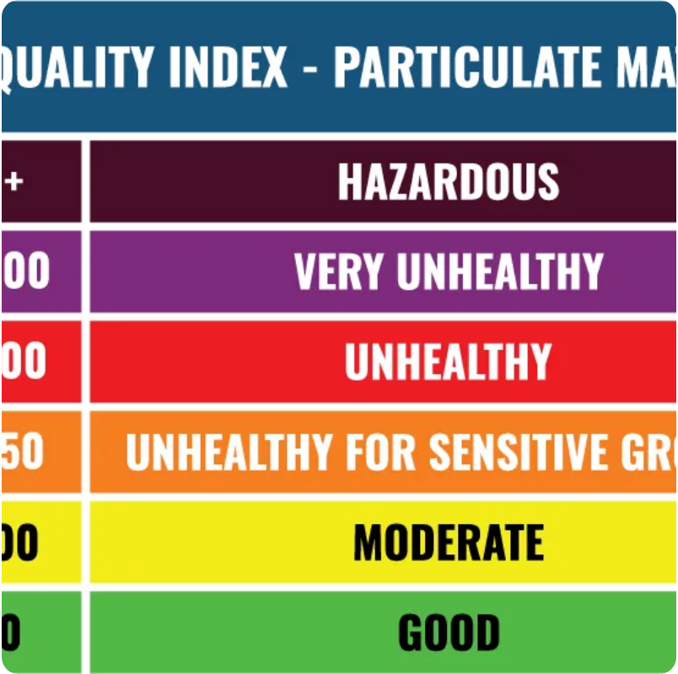
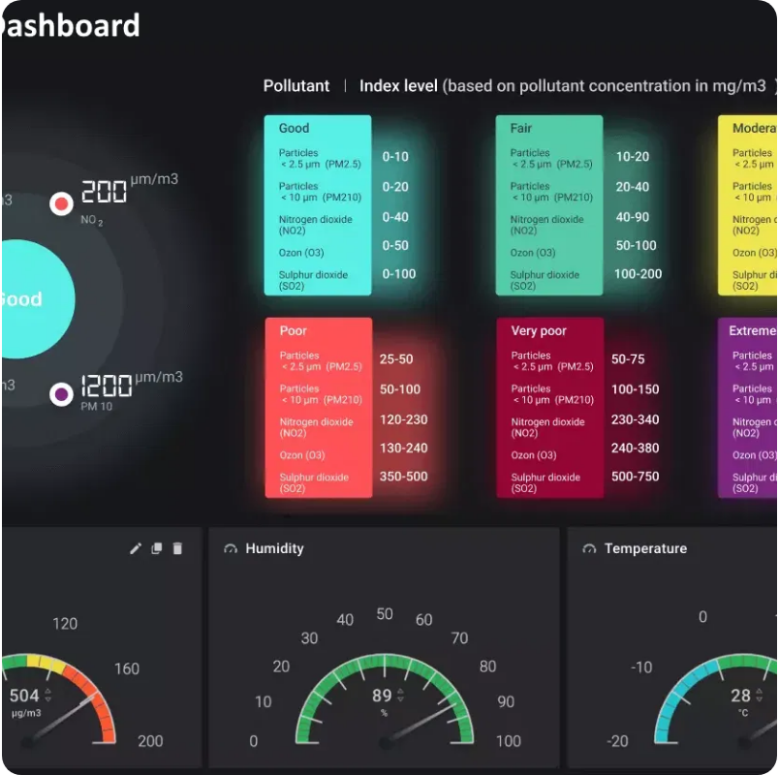
Key Features
Real-Time AQI
Historical Trends
Live air quality data from ground stations
Graph AQI/PM2.5/NO₂ over weeks or months
Satellite-derived pollution data for areas without monitoring stations
Compare data across different time periods
Satellite imagery correlation over time
Color-coded visualization (Green = Good, Red = Hazardous)
Data export for offline analysis
Detailed pollutant breakdown (PM2.5, PM10, NO₂, SO₂)
Forecasting
Health Advisory
3-day pollution level predictions
Personalized health recommendations based on AQI
Machine learning model using weather + historical AQI
Special advice for sensitive groups (children, elderly, respiratory conditions)
Hourly forecasts for the next 24 hours
Animated forecast maps showing pollution spread
Activity suggestions ('Wear a mask', 'Avoid jogging')
Push notifications for pollution spikes
Air Quality Visualizer and Forecast App
5/10

Slide 6








Machine Learning Model
Forecasting Algorithm
Hybrid Approach:
Combines time series analysis (ARIMA) with machine learning (Random Forest) for optimal prediction accuracy.
Input Features:
Historical AQI values (7 days), weather parameters (temperature, humidity, wind), day of week, and seasonal factors.
Processing Pipeline:
Data cleaning → Feature engineering → Model training → Ensemble prediction → Confidence calculation.
Model Performance
Feature Importance
Output:
72-hour AQI forecasts with hourly granularity and confidence scores for reliability assessment.
Continuous Learning:
Model retrains weekly with new data to improve accuracy and adapt to changing pollution patterns.
Air Quality Visualizer and Forecast App
6/10

Slide 7






Live Demo
Dashboard
Forecast
Historical
Health
Real-Time Updates
Dashboard automatically refreshes every 60 minutes, with manual refresh option for immediate updates. Color-coded indicators provide at-a-glance status.
Interactive Map
Zoom and pan to explore air quality across different regions. Click on markers to view detailed station information and historical trends.
Responsive Design
User Walkthrough
Application adapts seamlessly to different screen sizes, providing optimal experience on desktop, tablet, and mobile devices.
1
Select Location:
Choose a city from the dropdown or use geolocation to find the nearest monitoring stations.
2
View Current AQI:
Smart Notifications
See real-time air quality data with color-coded indicators and detailed pollutant breakdown.
Set custom AQI thresholds to receive alerts when air quality deteriorates beyond your comfort level.
3
Explore Map:
Interact with the map to view air quality in surrounding areas and identify pollution hotspots.
4
Check Forecast:
Navigate to the Forecast tab to view predictions for the coming days and plan activities accordingly.
Air Quality Visualizer and Forecast App
7/10

Slide 8

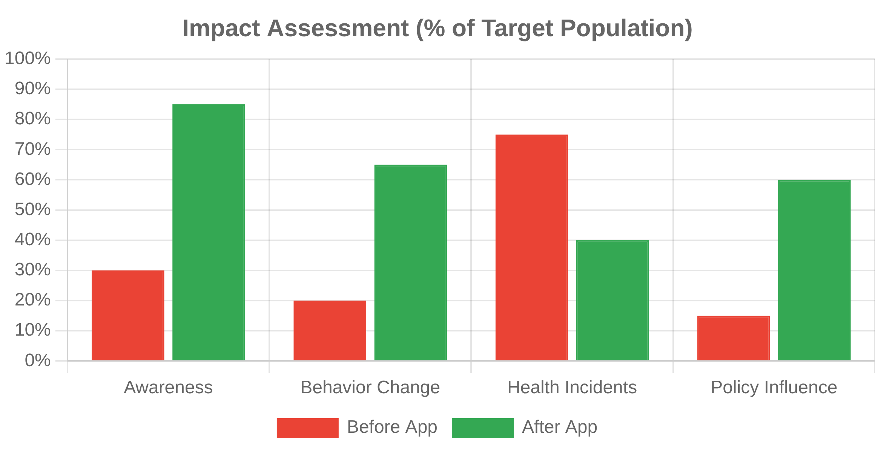




Benefits & Impact
Key Benefits
Measurable Impact
Improved Public Health
Enables individuals to make informed decisions about outdoor activities based on air quality, reducing exposure to harmful pollutants and associated health risks.
Environmental Awareness
Increases public understanding of air pollution sources, patterns, and impacts, fostering greater environmental consciousness and sustainable behaviors.
Community Empowerment
Provides underserved communities with access to critical air quality data, enabling advocacy for environmental justice and policy changes.
User Testimonials
Healthcare Integration
"As someone with asthma, this app has been life-changing. The forecasting feature helps me plan my outdoor activities and take precautions when needed."
Supports healthcare providers in advising patients with respiratory conditions, potentially reducing emergency room visits during high pollution events.
- Priya S., Delhi
"Our school uses the app to determine when children should stay indoors during recess. The hyperlocal data is much more accurate than what we had before."
- Rajesh M., School Principal
Air Quality Visualizer and Forecast App
8/10

Slide 9


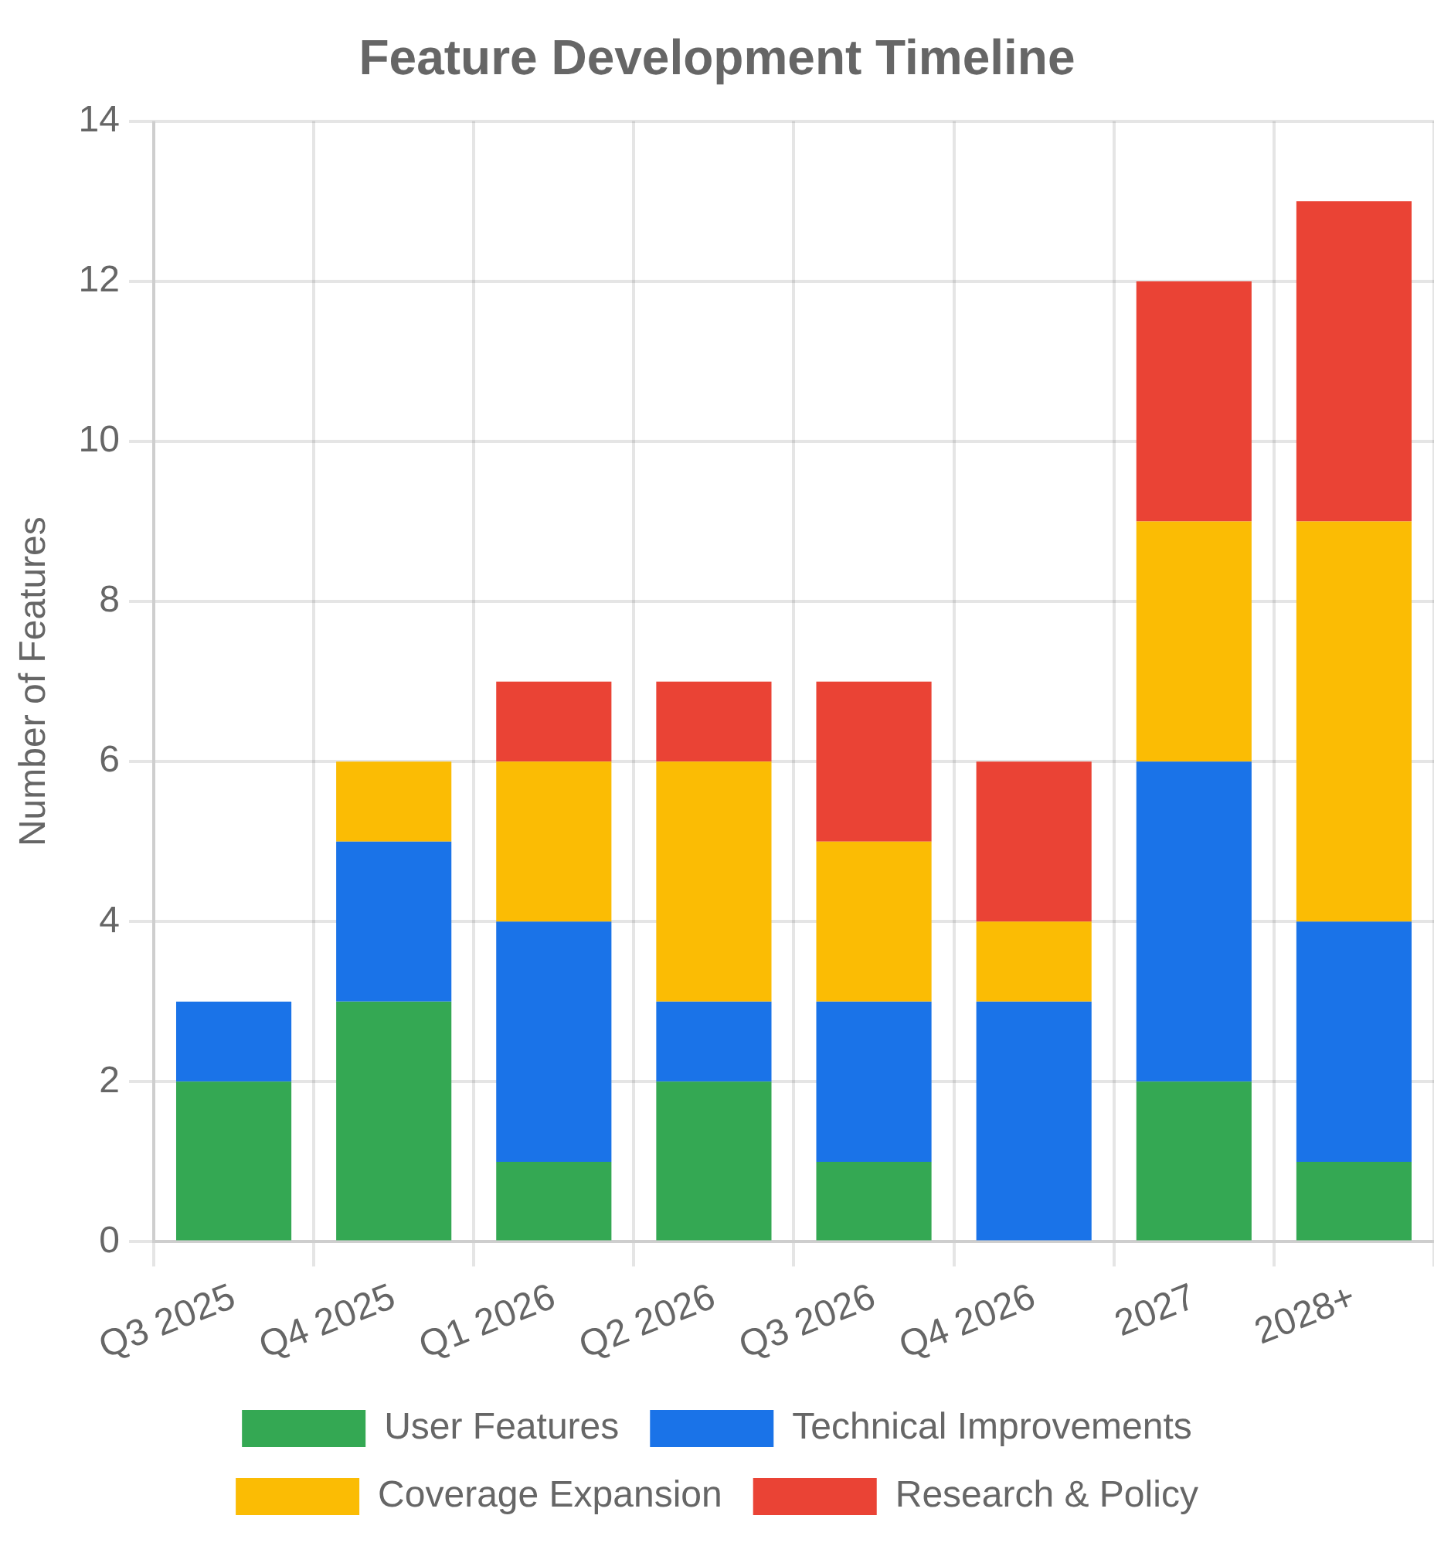




Future Enhancements
Development Roadmap
Development Timeline
Short-term Improvements (6 Months)
User accounts with personalized settings
Native mobile applications (Android/iOS)
Offline support for critical data
Coverage expansion to more rural areas
Medium-term Roadmap (1-2 Years)
Advanced ML models with deep learning
Pollution source identification
Community reporting features
Smart home device integration
Long-term Vision (3+ Years)
Global coverage expansion
Low-cost sensor network deployment
Policy impact assessment tools
Open research platform for scientists
Air Quality Visualizer and Forecast App
9/10

Slide 10








Conclusion
Breathing Easier with Data-Driven Insights
The Air Quality Visualizer and Forecast App bridges critical data gaps by providing hyperlocal, real-time, and predictive air quality information for all communities, including underserved regions. By combining ground station data, satellite imagery, and advanced machine learning, we empower individuals, communities, and policymakers to make informed decisions that protect health and improve environmental awareness.
Hyperlocal Coverage for Underserved Areas
Data-Driven Forecasting
Personalized Health Recommendations
Community Empowerment
Ready to Breathe Cleaner Air?
Join us in our mission to make air quality information accessible to everyone.
Get Started Today
airqualityapp.org
info@airqualityapp.org
+91 98765 43210
Air Quality Visualizer and Forecast App
10/10

